Slide 1
Laravel Concept Progress
Aman Aswal

Slide 2
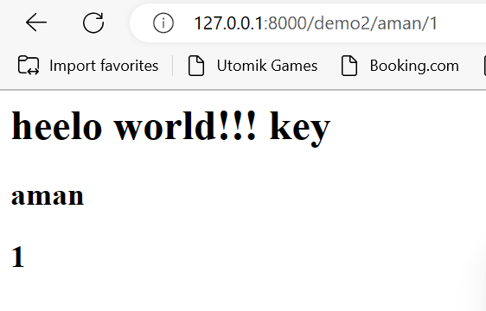
Routing
Route::get('demo2/{name}/{id?}',function($name,$id=null)
{
$data=compact('name','id');
return view('first')->with($data);
});

Slide 3
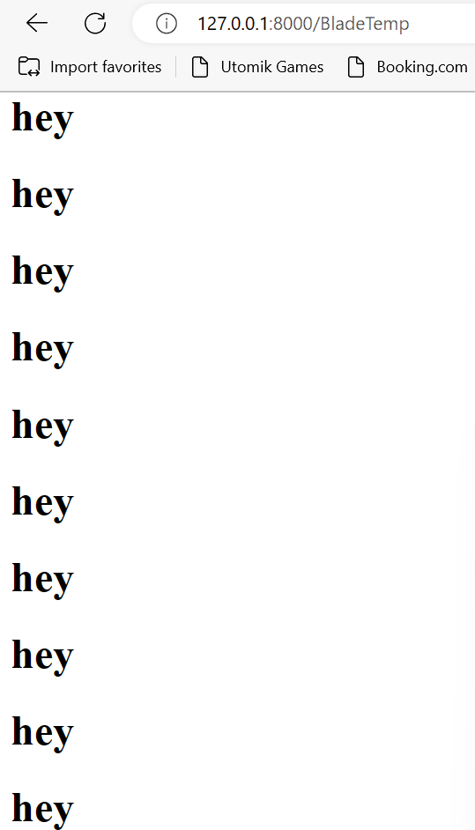
Blade Template
Route::get('BladeTemp',function()
{
return view ('trynow');
});
@for ($i=0;$i<10;$i++)
<h1>hey</h1>
@endfor

Slide 4
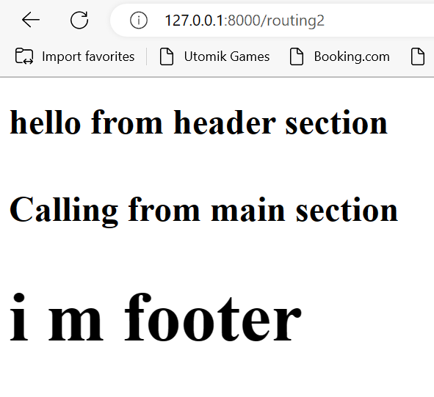
Layout of Blade Directives
@include ('layouts.header')
<div class="container">
@yield(‘main')
</div>
@include ('layouts.footer’)
@extends('layouts.main’)
@section(‘main')
<h4>
Calling from main section
</h4>
@endsection

Slide 5

Controller Step 1: Creating Route
Route::get('/custumers',[Customercontroller::class,'index’]);
Route::post('/custumers',[Customercontroller::class,'store’]);

Slide 6
Controller Step 2: Creating Controller & Functions
public function index()
{
return view('customer');
}
public function store(Request $request)
{
echo "<pre>";
print_r($request->all());
$customers=new Customer;
$customers->name=$request['username'];
$customers->password=$request['password'];
$customers->save();
}

Slide 7
Controller Step 3: Creating Model and connecting to our database
class Customer extends Model
{
use HasFactory;
protected $table="customers";
protected $primaryKey="id";
}

Slide 8
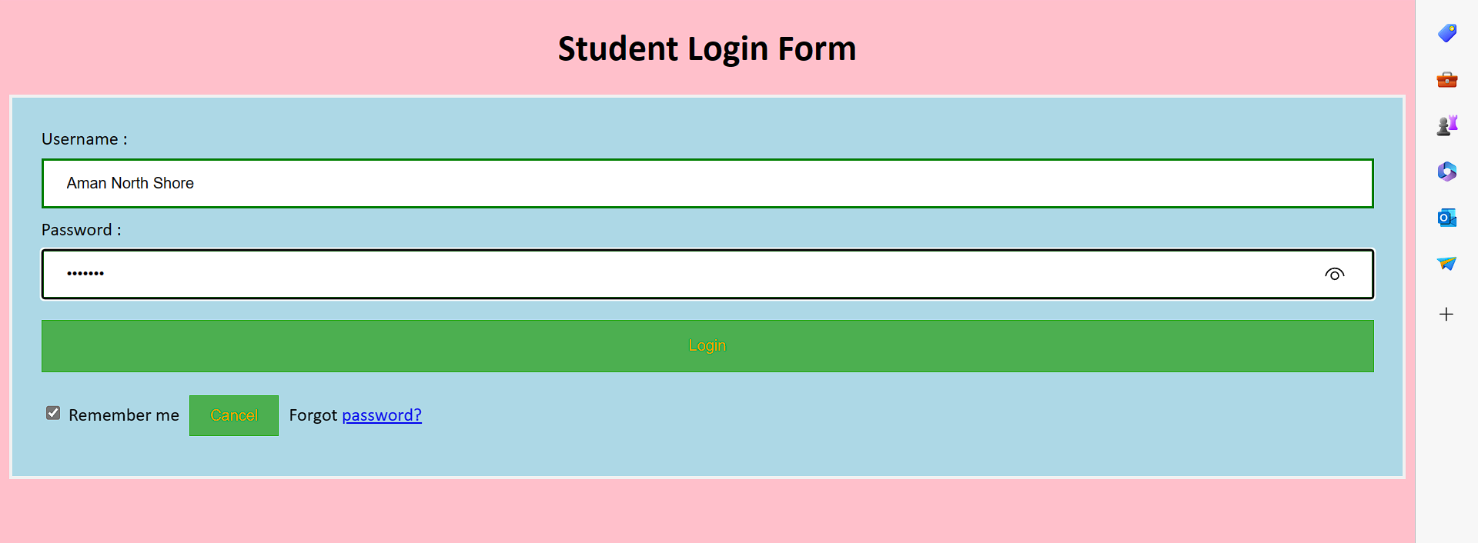
Controller Step 4: Creating View
<form action="{{url('/')}}/custumers" method="post">
@csrf {{-- to generate token --}}
<div class="container">
<label>Username : </label>
<input type="text" placeholder="Enter Username" name="username" required>
<label>Password : </label>
<input type="password" placeholder="Enter Password" name="password" required>
<button type="submit">Login</button>
<input type="checkbox" checked="checked"> Remember me
<button type="button" class="cancelbtn"> Cancel</button>
Forgot <a href="#"> password? </a>
</div>
</form>

Slide 9
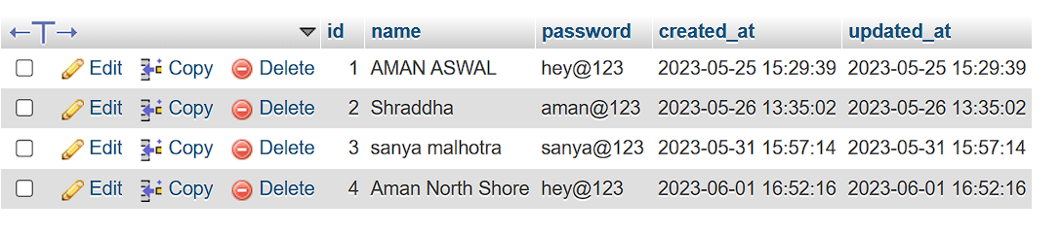
Step 5:Sending data to DB Via Post request

Slide 10
Other Topic Gone through so far:
Validation
Select query in data
Update query in data
Delete query in data
Handle Session
Seeder & Faker
Pagination

Slide 11
Thank you!

